Slide 1
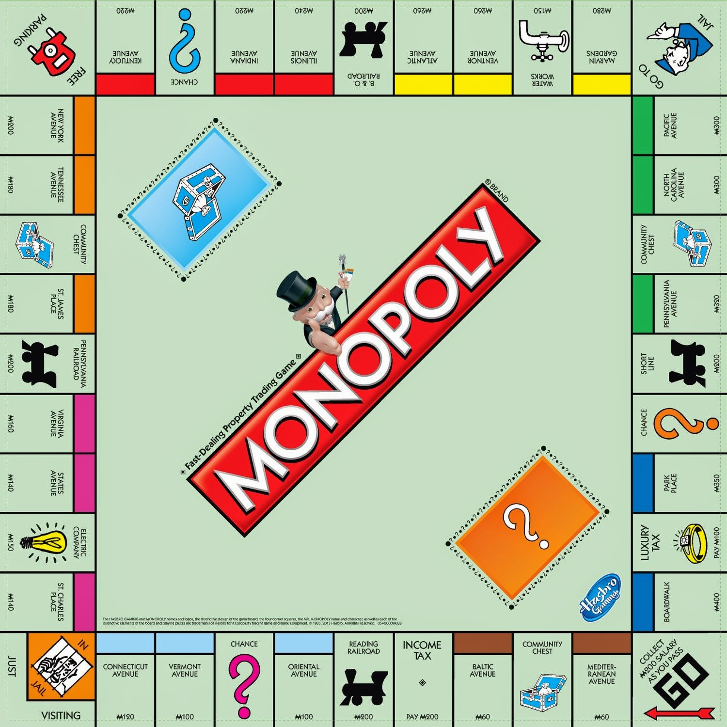
Monopoly
Objectives:
Use the game of Monopoly to understand systems/structures that promote and perpetuate inequality in society
Agenda:
Monopoly
Reflection
Discussion
HW:
Work on Econ project
This Photo by Unknown Author is licensed under CC BY

Slide 2
Period 1 Groups
Group 1 | Group 2 | Group 3 | Group 4
Maya | Kaylie | Abby | Riley
Marisa | Nathan F | Skye | Lillian
Isha | Nicole | Joseph | Cole
Ryan | Katy | Aaron | Mac
Ben | Aliera | Vandhana | Nathan
Bernita | Ethan | Kyra | Seth
Sam C | Amogh | Alec | Sam V

Slide 3
Period 3 Groups
Group 1 | Group 2 | Group 3 | Group 4 | Group 5
Dylan | Josie | Lainie | Priti | Andy
Amber | Tasha H. | Shad | Jillian | Alex
Lindsey | Callie | Nathan | Kaylin | Kyle M.
Maddie | Kolby | Leah | Arantxa | Tasha S.
Carter | Tara | Ellie | Kyla | Anvita
Julia | Joey

Slide 4
Period 7 Groups
Group 1 | Group 2 | Group 3 | Group 4
Safia | Kyle | Kabir | Violette
Helena | Dennis | Ryan | Nick
Camille | Alex | Ellen | Allison W
Shannon | Kaitlin | Nate | Casey
Jocelyn | Emma | Shavi | Mitchell
Ishanie | Mia | Dan | Ian
Alison D

Slide 5
The Rules (follow the rules on the directions in the box).
Privileged = Top Hat
Get out of jail free
$1,500 to start
$200 payday
2 die
Banker & Rule Enforcement
Single person
Observer
Handout
Oppressed = Dinosaur
$750 to start
$100 payday
1 die
Notes:
Play game 20 mins

Slide 6
4-Step Process x 3 “What’s”
Silent self-reflection
Small (role-based) group discussion
Role group discussion
Whole group insight
Notes:
1min

Slide 7
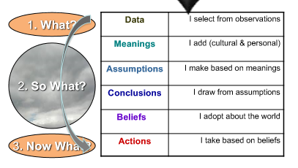
3 “What’s” → Observable Data

Slide 8
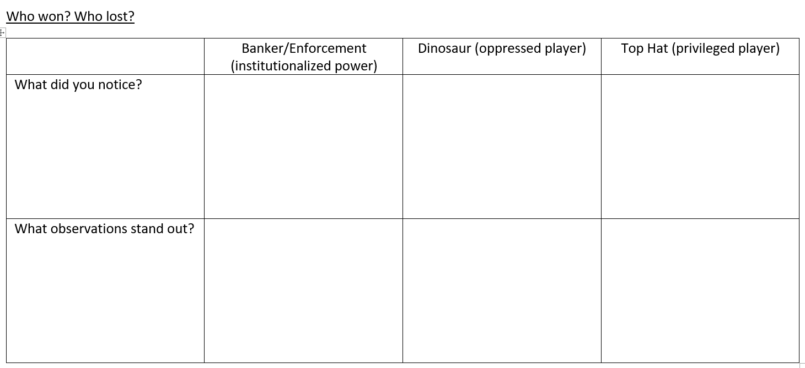
Round 1: What?
Identify Key Observations (including who won/lost)
What happened? Just the observable facts.
Neutral and judgment-free this round
NO opinions (not what you expected, assumed, wanted, or believe it should have been)
Just how it was (like it or not)
Notes:
5 on their own
When they are with their group they pick a note taker and a presenter
5 with their group
5 to share out

Slide 9
Role Debrief. Discuss what happened. ONLY OBSERVABLE DATA.
Horner’s classes
Dinosaurs →Front tables by the door
Top Hats → Front tables by the window
Bankers/Enforcement →back tables by the pod
Observers →back tables by my desk
Hodgins’s class
Dinosaurs → under the UW Comp bulletin board
Top Hats → outside of the Pod door
Bankers/Enforcement → next to the podium
Observers → in front of my desk

Slide 10
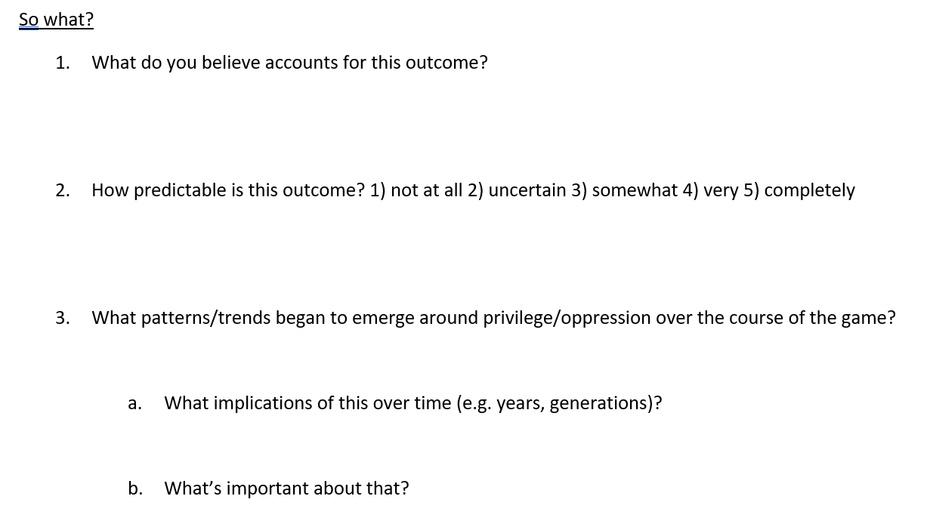
Round 2: So What?
Identify reoccurring /collective patterns, conclusions, and their significance.
Notes:
5 on their own
Pick a note taker and a presenter 5-with their group
5 to share out

Slide 11
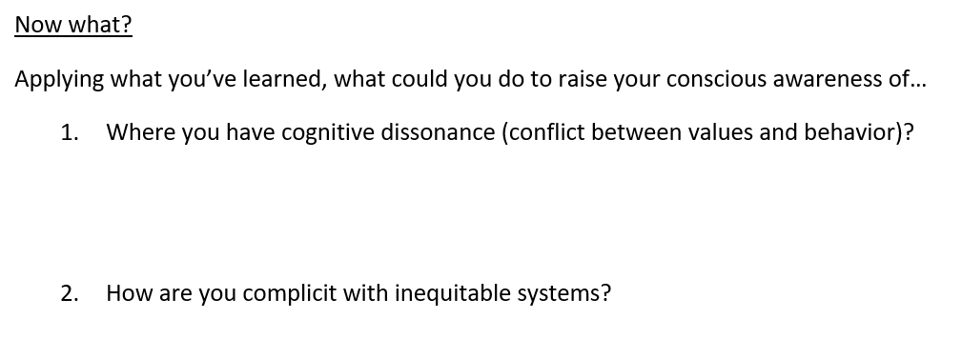
Round 3: Now What?
Identify practices to raise self-awareness of conflicting values and behavior.
To develop the skill of seeing dissonance within larger systems, start with the system in yourself.
Notes:
5 mins

Slide 12
Psychology of Privilege Discussion
Consider what we’ve learned in class this year…how does this game relate to the theme of Margins and Centers?
How does this relate to the Econ Simulation project?
Notes:
5 mins on their own
10 min class discussion

